Slide 1
Coin Recognition
Martin Schacherl, Christoph Fuchs,
Roman Hochstöger
Image Understanding LU
Pattern Recognition and Image Processing Group
Institute of Computer Graphics and Algorithms
Vienna University of Technology

Slide 2

Overview
Who did what
Specifiation – Goal
Difficulties
Solution – Segmentation
Solution – Log-Polar Transformation
Solution – Feature Extraction
Solution – Classification
Verification – Results
Result – Example
Literature
Martin Schacherl

Slide 3


Who did what
Christoph
  feature extraction DFT
  log-polar transformation
Roman
  cross-validation
  houge transformation
Martin
  documentation and classification
Martin Schacherl

Slide 4
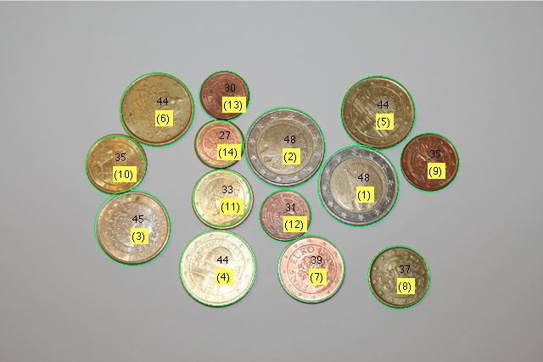
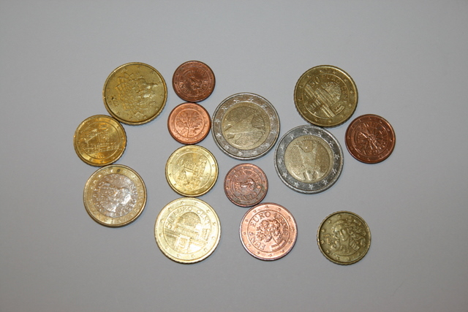
Specification - Goal
Recognition of Euro-coins in an image
Value of coins should be calculated automatically
Calculation: 2x€2+1x€1+3x€0,50+3x€0,10+1x€0,05+1x€0,02+3x€0,01= € 6,90-
Martin Schacherl

Slide 5
Difficulties regarding Coin Recognition
Viewpoint/perspective
Coin partially overlapped (by other coin)
Rotation
Frontside/backside of the coin
Euro Coins: Different countries – different backsides
(Flash-) Light reflected by coin
Impurities
Martin Schacherl

Slide 6
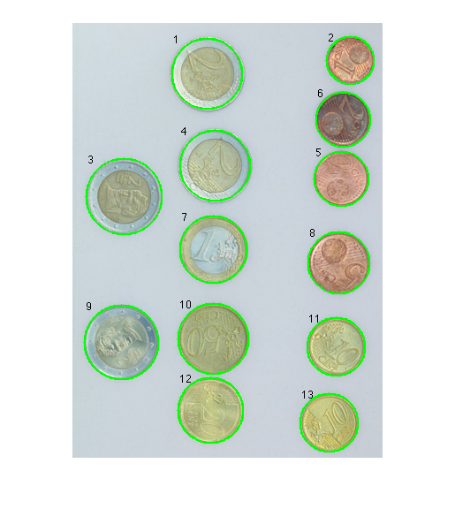
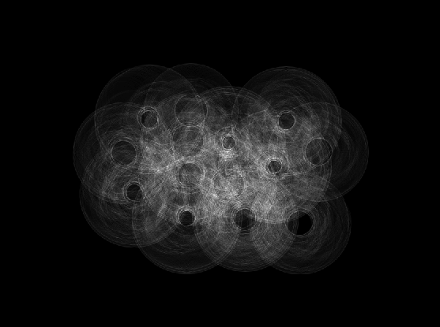
Solution - Segmentation
Hough Transform
  Grayscale image – Canny edge detector – binary image
  Reduce complexity: min/max radius
  Transformation into Hough space
  Hough-space: search for best accumulation points
  Delete lower accumulation points
Martin Schacherl

Slide 7
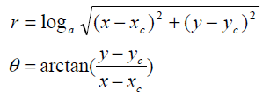
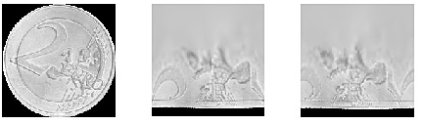
Solution – Log-Polar Transformation
Aim: rotation invariant recognition
Log-polar transformation:
  Pixel coordinates transformed to polar coordinates (relative to center point)
Rotation corresponds to x-axis shift:
Martin Schacherl

Slide 8

Solution – Feature Extraction
Rows of transformed data transformed to Fourier space
50 Fourier coefficients per line
  first coefficient rejected (average grey value)
  Absolute values of coefficients 2-16 used (most significant information)
Size invariance: y-Axis segmented into 10%-segments
  Each segment represents a concentric circle around a coin
  Features: mean value, variance
Martin Schacherl

Slide 9
Solution - Classification
Euclidean
  Euclidean distance between feature vector and vectors of training set calculated
  Classified to class of vector with minimal distance
Polynomial Support Vector Machine
  Transformation of feature vectors to hyperdimensional space
  Decision boundary calculated – back transformation
Martin Schacherl

Slide 10
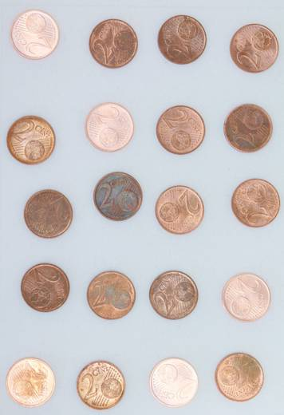
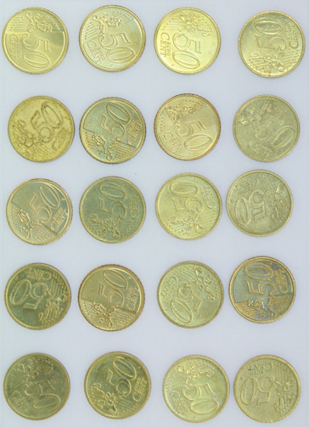
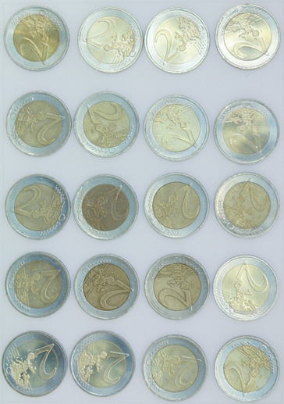


Verification - Results
Self-made training set
  austrian euro coins : 20 different images for each coin
Improvement: Classification color channel-wise
Results:
SVM amount | SVM corr. coin side | EUK amount | EUK corr. coin side
0.8165 | 0.6804 | 0.7753 | 0.3924 | Greyscale
0.9082 | 0.7057 | 0.8924 | 0.4304 | Greyscale+ color channels
0.9177 | 0.6994 | 0.8892 | 0.4241 | Color channels
0.9177 | 0.6994 | 0.8892 | 0.4241 | Color channels+ radius
Martin Schacherl

Slide 11
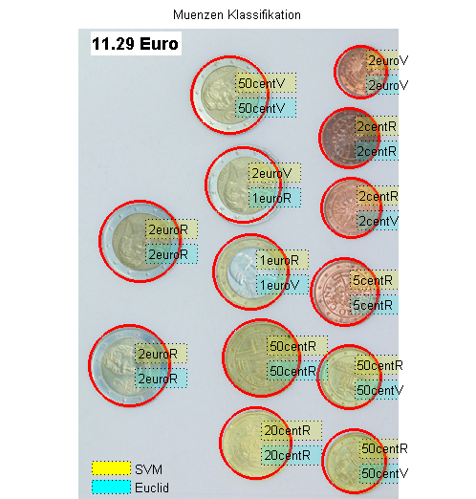
Result - Example
check out at: http://code.google.com/p/coinrecognition
Martin Schacherl

Slide 12
Literature
CHEN Cai-ming et al., „A coin recognition system with Rotation invariance“, Proceedings of the 2010 IEEE International Conference on Machine Vision and Human-machine interface, pp. 755-757, 2010
KAMPEL M., Zaharieva M., „Recognizing ancient coins based on local features“, Proceedings of the 4th international symposium on visual computing, pp. 11-22, 2008
MITSUKURA Yasue et al., „Design and evaluation of neural networks for Coin recognition by using GA and SA“, Proceedings of the IEEE-INNS-ENNS International Joint Conference on Neural Networks, pp. 178-183, 2000
Martin Schacherl

